Slide 1


Stage_Zero
Sales Analysis Project
By Rofiat Muhammad | Data Analyst
Date: 10th of October 2025.
Rofiat Muhammad

Slide 2

Dataset Overview
Dataset Title: Sales Dataset.
Data Source: Kaggle.
Rows: 1,194 rows.
Columns: 12 columns.
Link:
https://www.kaggle.com/datasets/shantanugarg274/sales-dataset

Slide 3
Dataset Variables
Order ID (Text): Unique order number.
Revenue (Currency): Total Revenue (in USD).
Profit (Currency): Profit per transaction.
Quantity (Number): Units sold.
Category and Sub-Category (Text): Product type.
Payment Mode (Text): Payment Method used.
Order Date (Date): Transaction Date.
Customer Name, State, City (Text): Location and customer info.
Year-Month (Text): Transaction Month and year.

Slide 4

Research Question
What is the sales trend over the years?
What is the relationship between revenue and profit in each State?
What is the contribution of each category to the overall profit?

Slide 5

Data Cleaning Summary
Created a new column for Year from Year-Month.
Sorted data by Category and Profit for comparison.
Category and payment modes were standardized for consistency.
Checked for missing, duplicate rows, and blank cells (none found).
Checked for possible Outliers and Typographical errors.
Verified data types:
Dates were converted to Excel date format.
Changed Revenue, Profit, and Quantity to Number format.

Slide 6
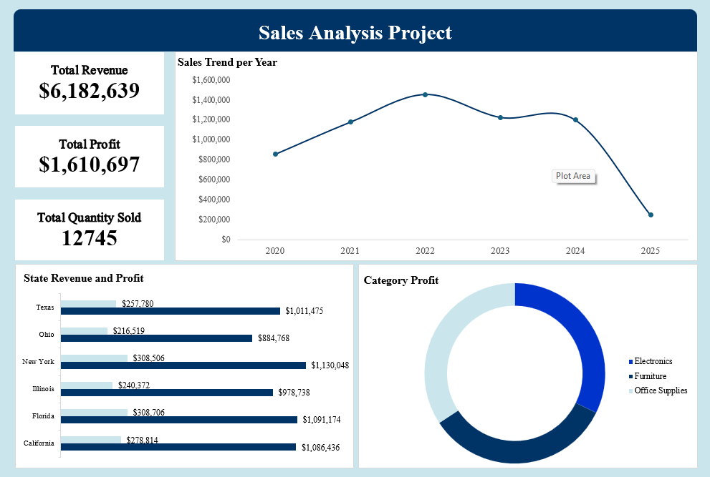

Slide 7
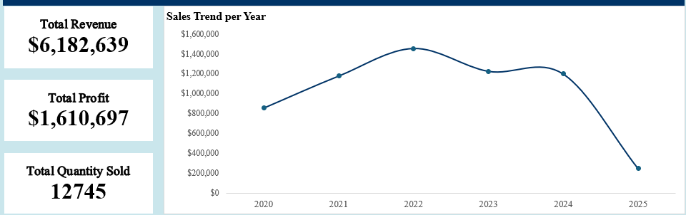
Total Revenue: $6,182,639
Total Profit: $1,610,697
Total Quantity Sold: 12,745
These metrics provide an overview of the company’s overall performance from 2020 to 2025.
Sales Trend per Year (Line Chart)
Sales increased steadily from 2020 to 2022, peaking at around $1.5M.
However, there was a decline in 2024 and a sharp drop in 2025, This drop is likely due to
limited data records for 2025, which may not fully represent that year’s performance.

Slide 8
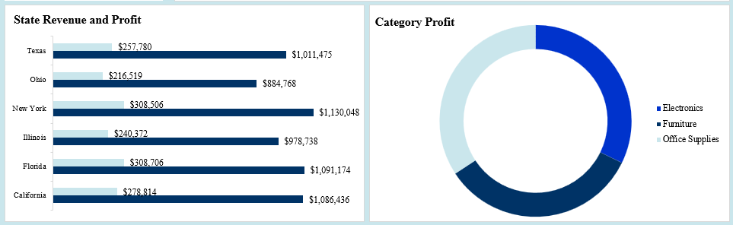
State Revenue and Profit (Bar Chart)
New York, Florida, and California recorded the highest total Revenue and profits.
Ohio and Illinois had lower sales and profits, which may need further investigation
Category Profit (Donut Chart)
Electronics contributed the largest share of profit, then by Furniture and Office Supplies.
This shows which product line drives the most business revenue.

Slide 9
Conclusions
The business performed strongly between 2020–2023 but experienced a downturn in 2024.
Limited data records for 2025 may not fully represent that year’s performance.
Management should focus on understanding the cause of declining sales and replicating successful strategies from New York and Florida in weaker regions.
Expanding the Electronics segment could further boost profit.

Slide 10

Limitations
The dataset covers only six states, which may not represent all markets.
Data on marketing spend or customer behavior is missing, which limits deeper insight into the causes of sales changes.
Future Work
Collect more recent or complete data for 2025 onward.
Use of Power BI for advanced visualizations in later stages.
Perform predictive analysis to forecast future sales trends.

